Slide 1
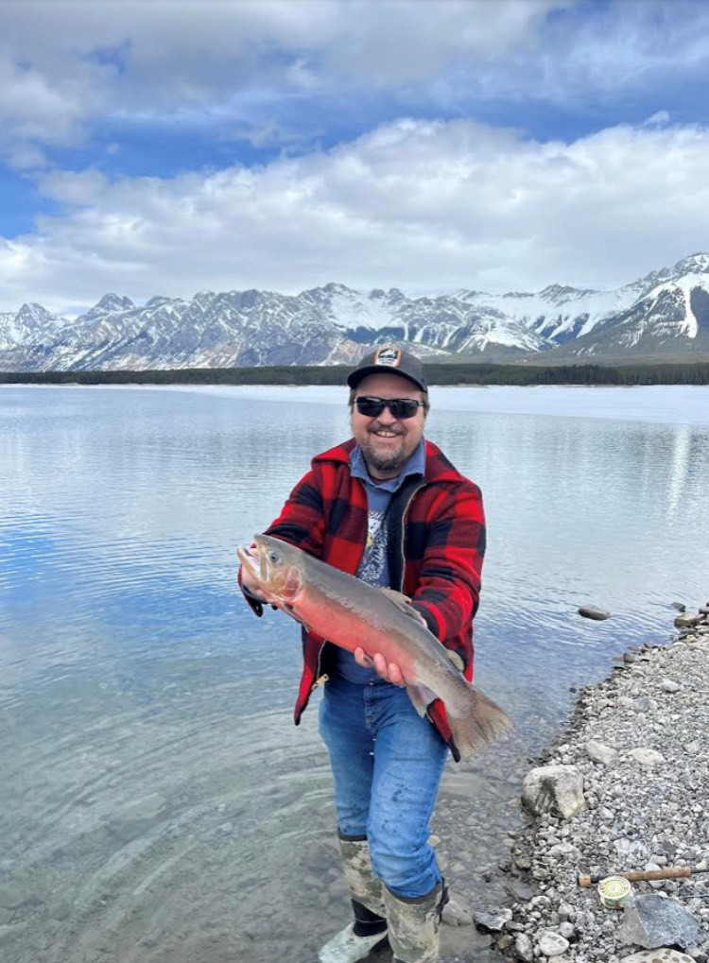
Alberta Fish Stocking Operations
This icon may be removed or changed should you find one more appropriate for your presentation. See the last two slides for a selection of icons or use the Icon Generator at https://corporateidentity.alberta.ca/goaaccess/icongen/
World Trout Summit
Craig Copeland Manager Fish Stocking Operations
Environment and Protected Areas
Notes:
Tips:
use an icon that best represents the concept you are presenting on. Icons are available at: alberta.ca/identity
If you don’t have a subtitle, move your name and title up to create balance with the main title

Slide 2
Purpose of Fish Stocking
Create recreational fishing opportunities throughout Alberta
Waterbody must have public access
Alberta lacks natural lakes with sportfish so through stocking we have introduced fish that can be caught and harvested with a high daily catch limit

Slide 3
Hatcheries – 4 built btw 1950-1986
Adult Brood Stations (2) – primary role is to provide eyed eggs for the two production hatcheries and private aquaculture industry (Allison and Raven)
Production Hatcheries (2) – primary role is to raise a fish to the stocked size and number requested by fisheries biologist. Provide small fingerlings to the private aquaculture industry. (SLFH and CLFH)
One dedicated quarantine facility at SLFH – wild eggs

Slide 4
What we raise and stock
Rainbow Trout – five different strains
Brown Trout
Brook Trout
Tiger Trout
Cutthroat Trout (Westslope)
Walleye
In the past we have raised Bull Trout, Grayling and Lake Trout

Slide 5
Fish Stocking Impact to AB Economy
Anglers spend >$160 million per year on fishing stocked lakes – benefit was utilized in Treasury Board capital funding requests
Our yearly operating costs 1:18 return to the economy
Hatcheries also supply eyed eggs and fingerlings to the Private Aquaculture Industry – helping hand relationship to provide fish for the private pond or table market
Hatcheries also involve private industry to supply RNTR to meet our targets.

Slide 6
Revitalization of the Hatcheries
Ministry re-org moved hatcheries under Water Infrastructure Branch (Dams)
Capital reinvestment in facilities - modernization RAS
Past 6 years >$33 million investment in replacement of RAS at SLFH, Allison Creek and PRAS at Cold Lake.
All three projects aquaculture discipline part of construction team that designed project for bid/build

Slide 7
Raven Brood Trout Station Replacement
State of the art design dedicated RAS water systems for each brood program (4) and production
Increase our ability to house species at risk brood programs – Athabasca RNTR, Bull Trout, WSCT, Grayling
Increase our fish stocking capacity by 13%
Inflation, Aquaculture supply chain issues, tight trade industry and uniqueness of building a hatchery in AB
tender price came in 180% then what is available

Slide 8
Water Source and Treatment
Well water at Allison Creek and Sam Livingston
Lake water treated with ozone Cold Lake
Natural Springs at Raven
RAS – systems treating 80 l/sec to 500 l/sec
Cold Lake PRAS – system treating 470 l/sec (78% re-use 22% fresh)

Slide 9
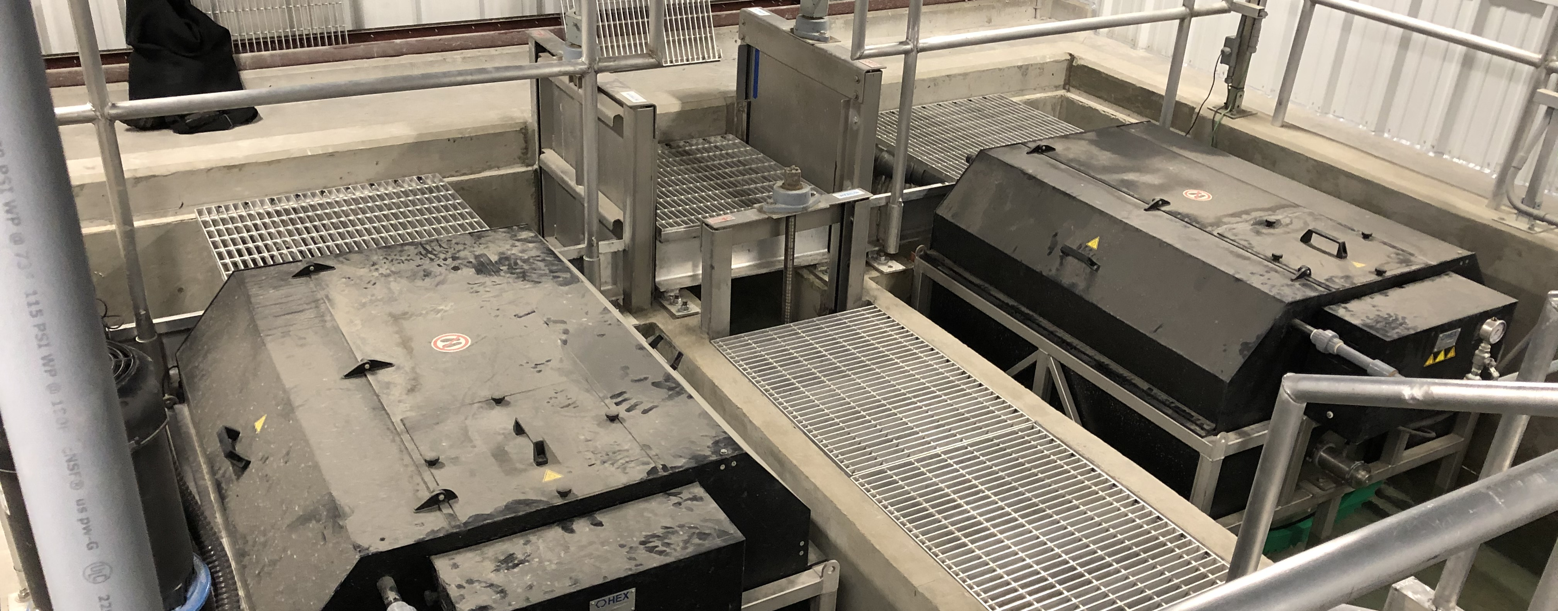
RAS system – rotating Drum Filters first step

Slide 10
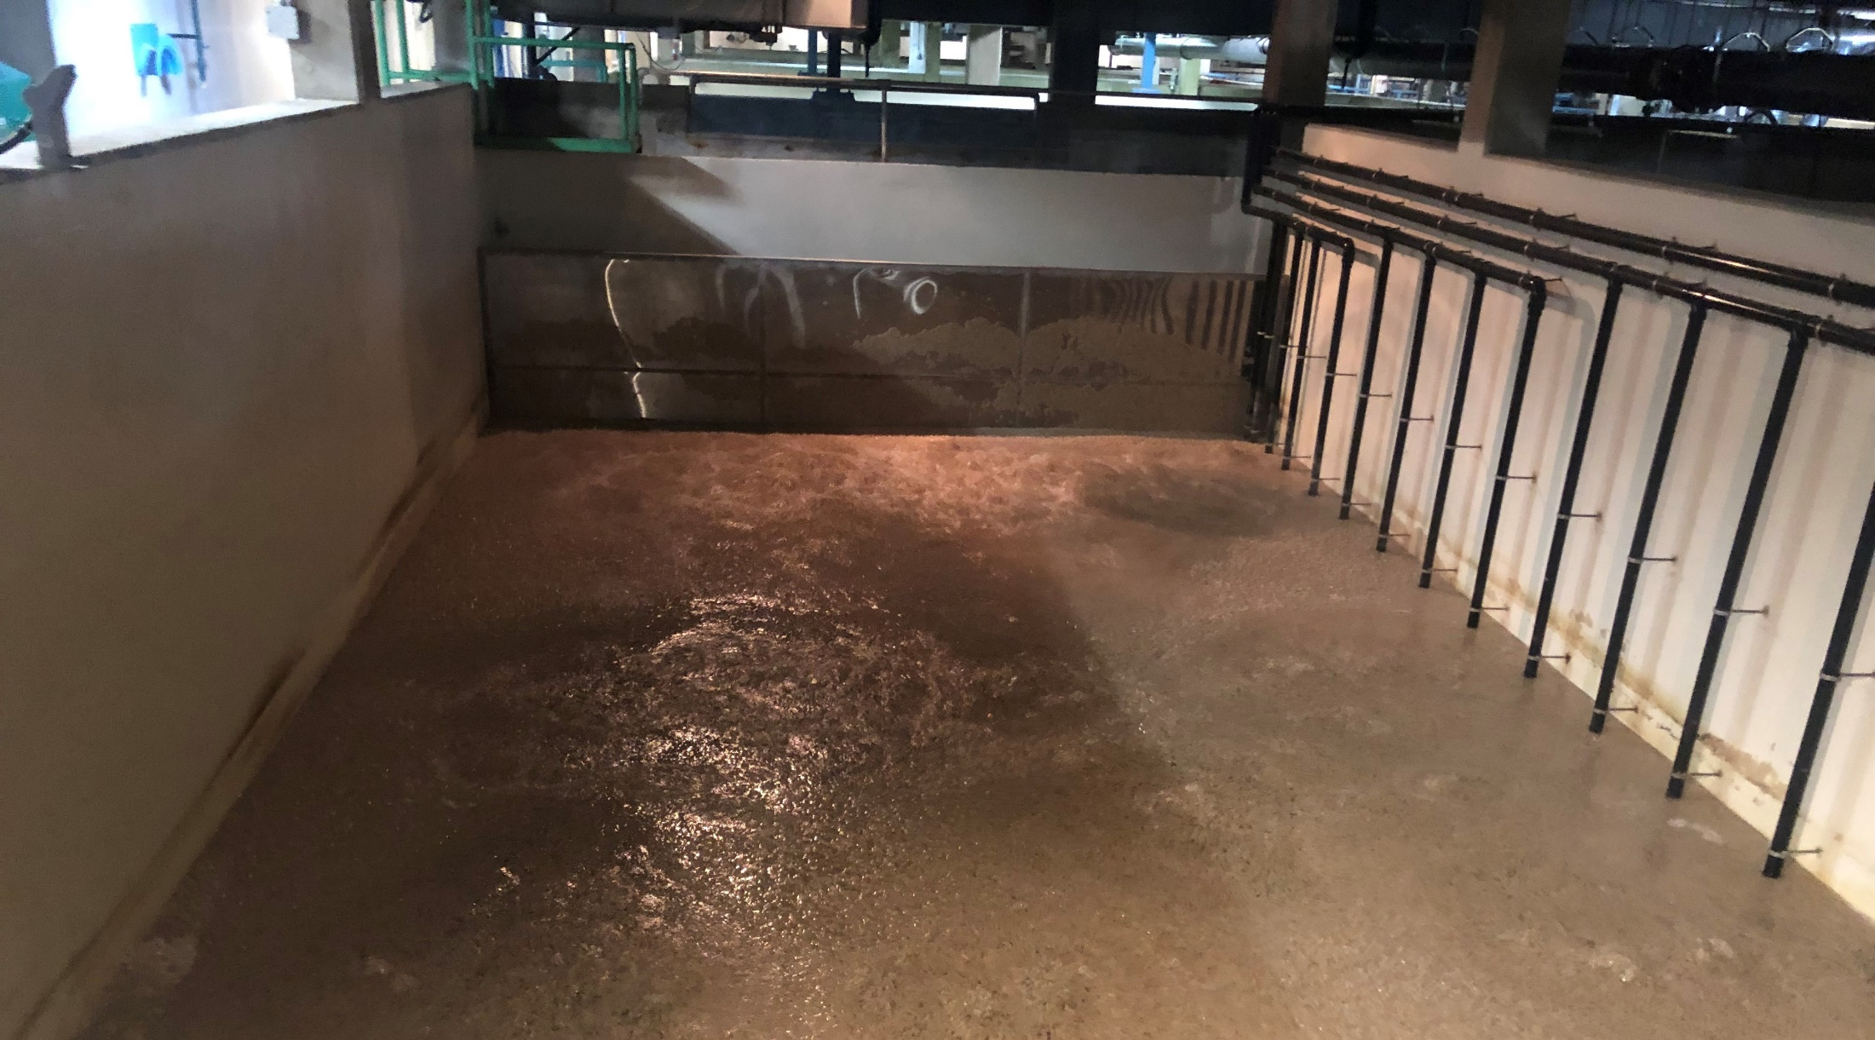
Moving Bed Biofilter Reactor – Converts Toxic Ammonia to Nitrates

Slide 11
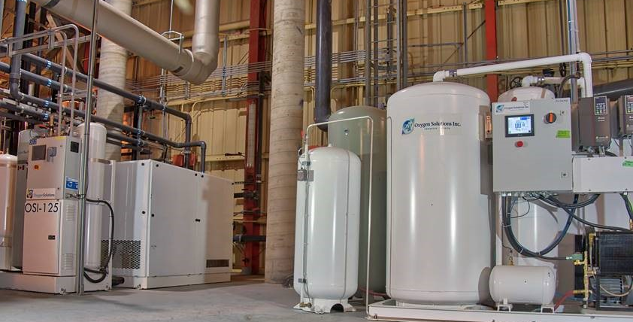

Slide 12
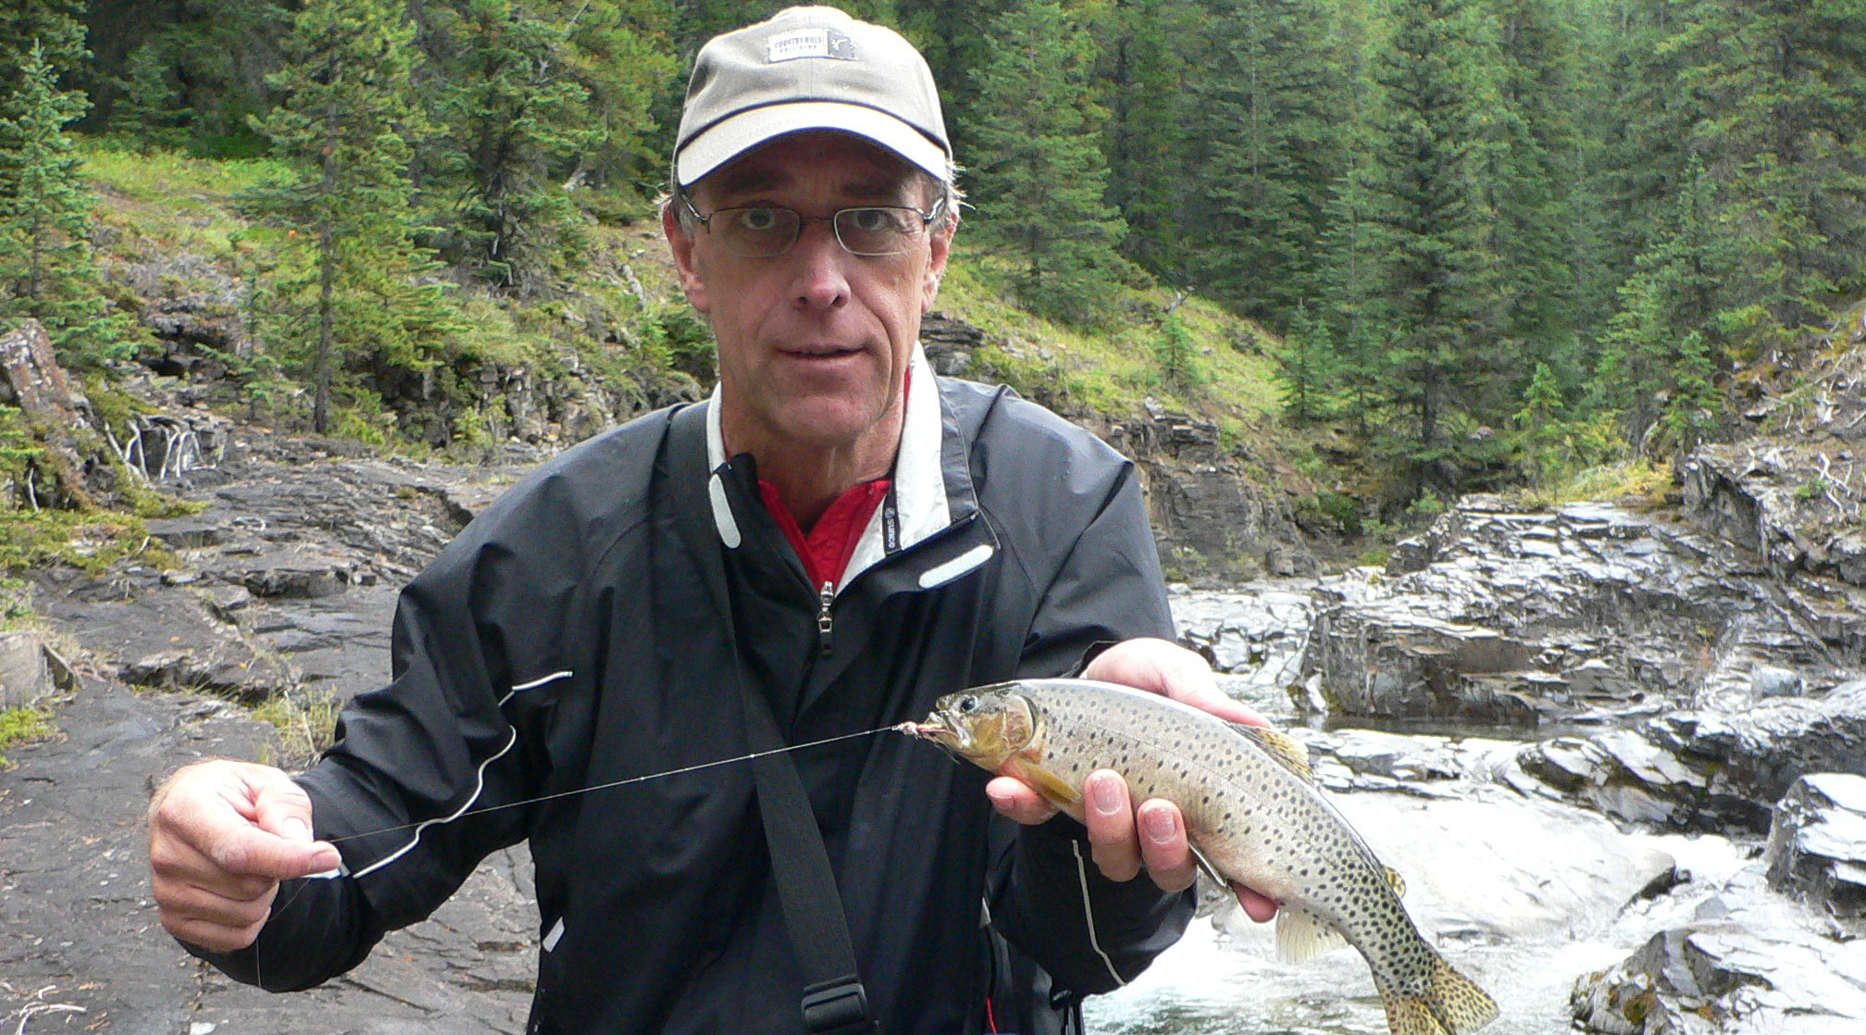
Westslope CTTR

Slide 13
Restoration - Westslope Cutthroat Trout
Tour to Montana understand what they are doing led to in 2018 sampling WSCT spawning in the field and returning the eyed eggs to select sites (RSI) for the fry to hatch
Progressed in 2021 to the development of a composite WSCT brood program housed at Allison Creek – first eggs 2024
Field fisheries staff sampled fish in many locations to identify if population is pure. Also identify locations that can be stocked with pure WSCT

Slide 14
Quarantine trailer – eggs incubate till eyed
Adult Spawning

Slide 15
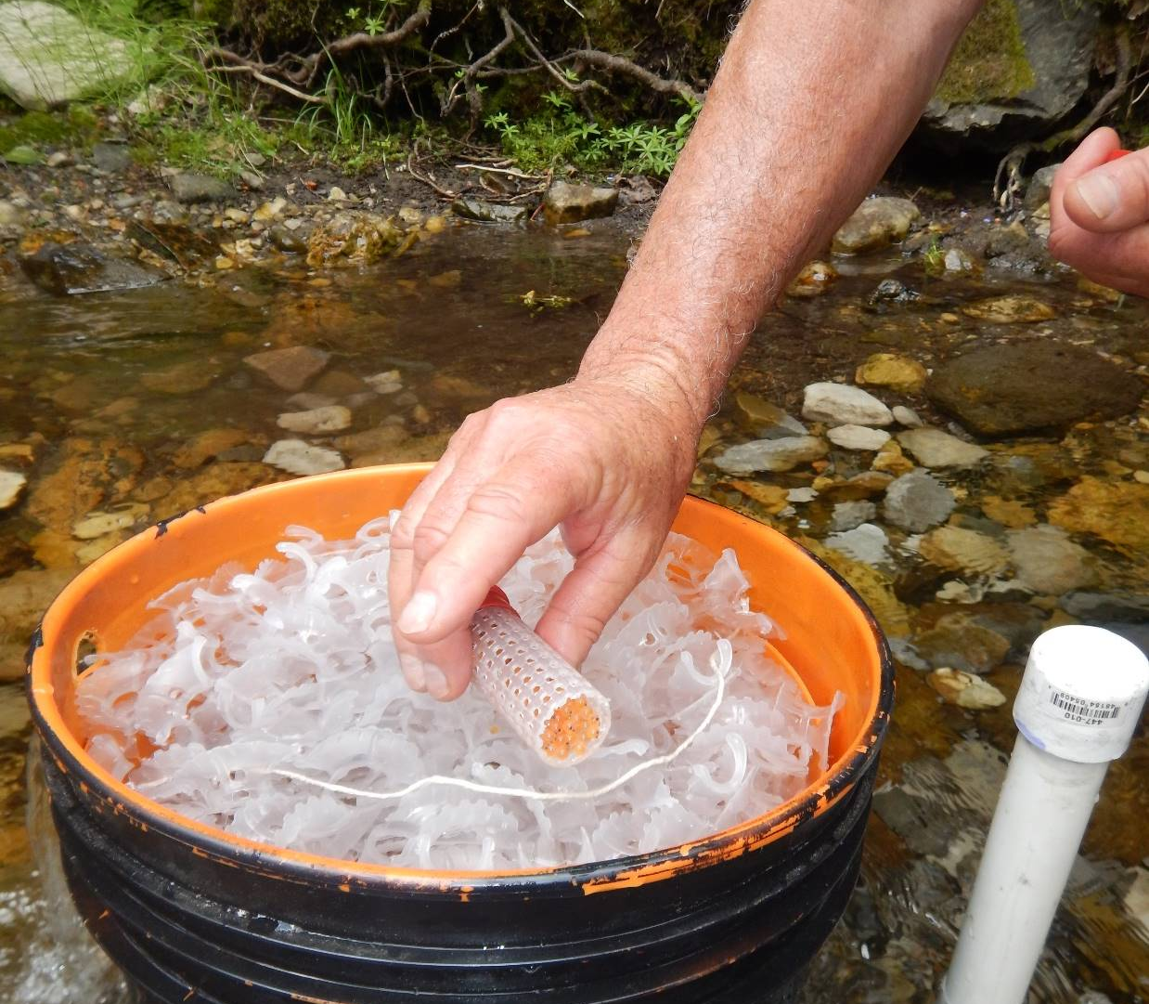
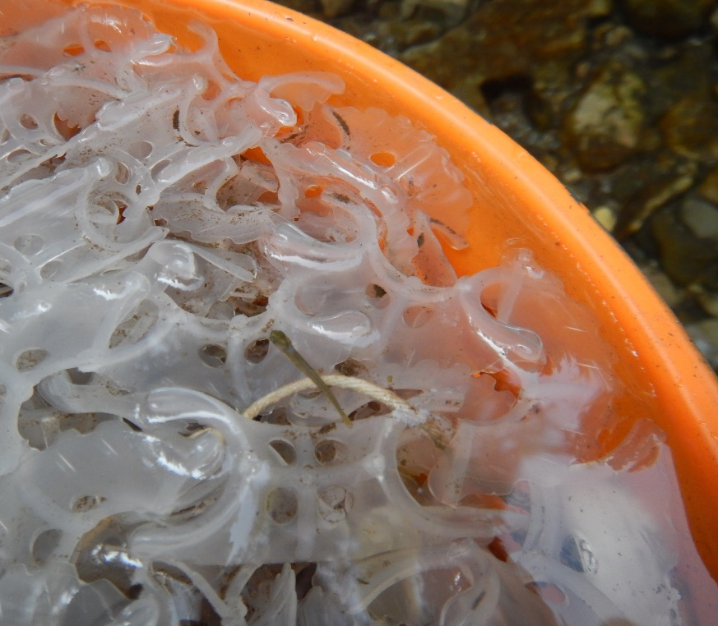
Fry emerge and swim out
RSI – remote stream incubators eyed eggs placed in packing

Slide 16
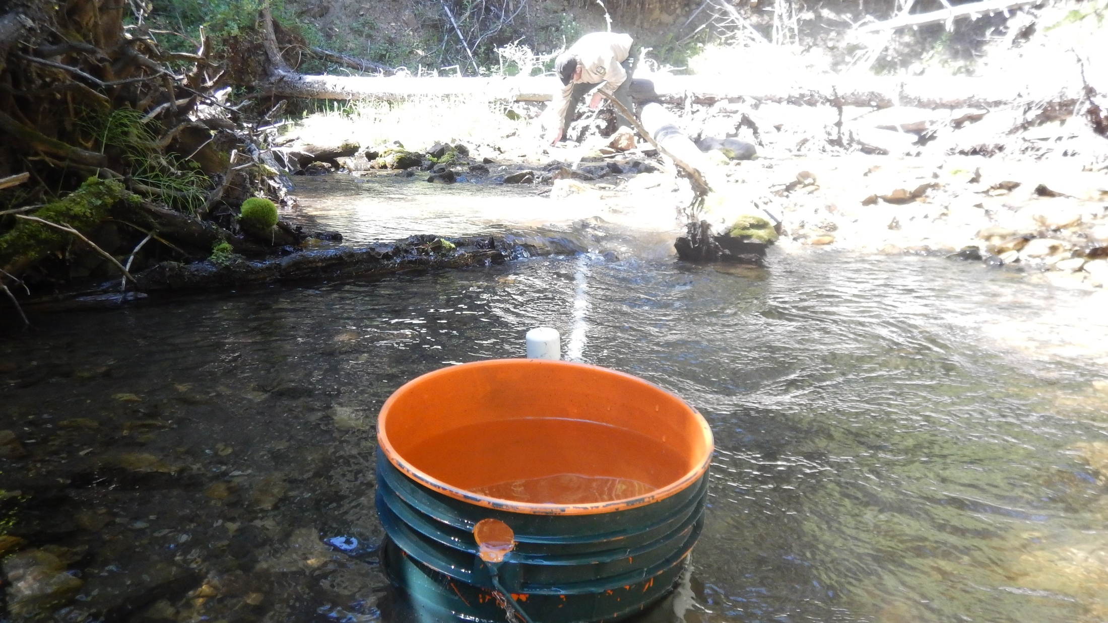

Slide 17
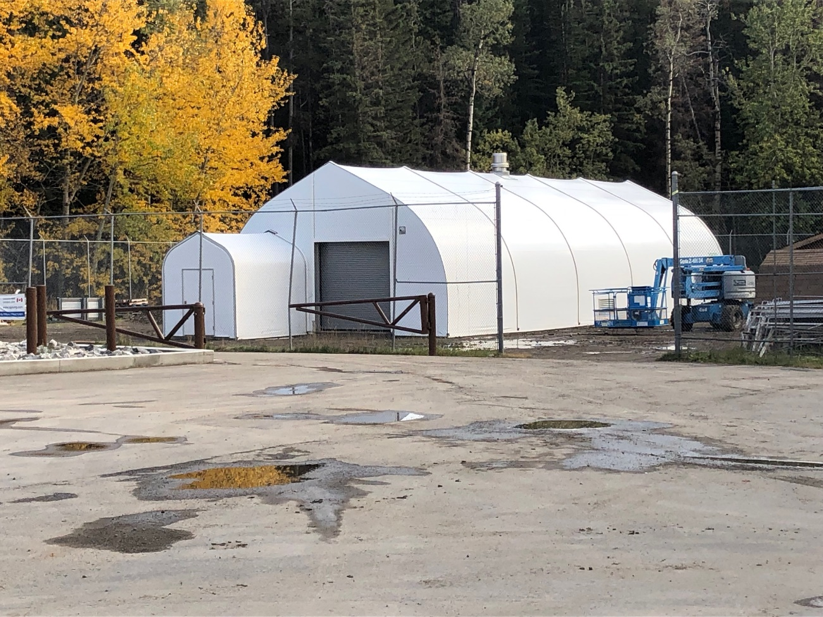
Wild Fish Quarantine Building – Allison Creek
DFO and Alberta relationship
Will provide a stand-alone RAS system to hold wild fish for spawning/genetic purposes.
5 segregated RAS units with egg incubation/hatching capabilities to potentially hold multiple species/strains at one time

Slide 18
Individual RAS system
Five separate systems

Slide 19
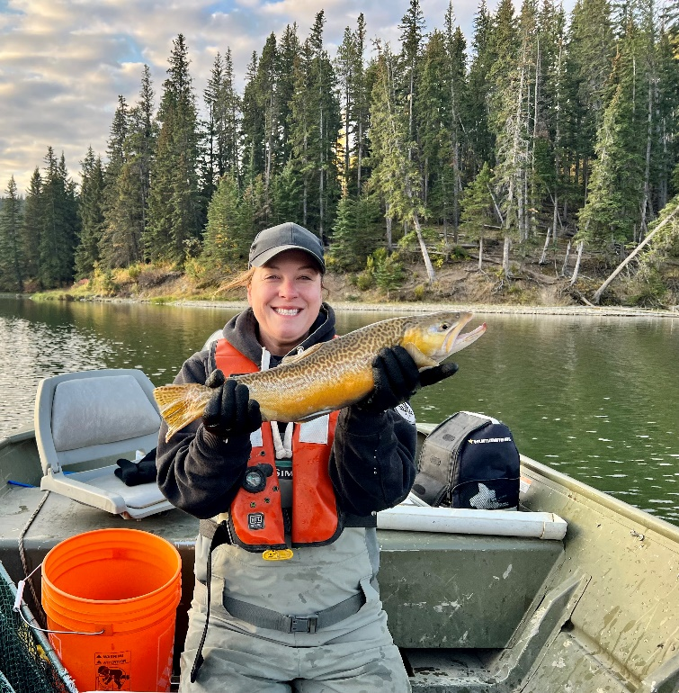
Questions – craig.copeland@gov.ab.ca

